Slide 1
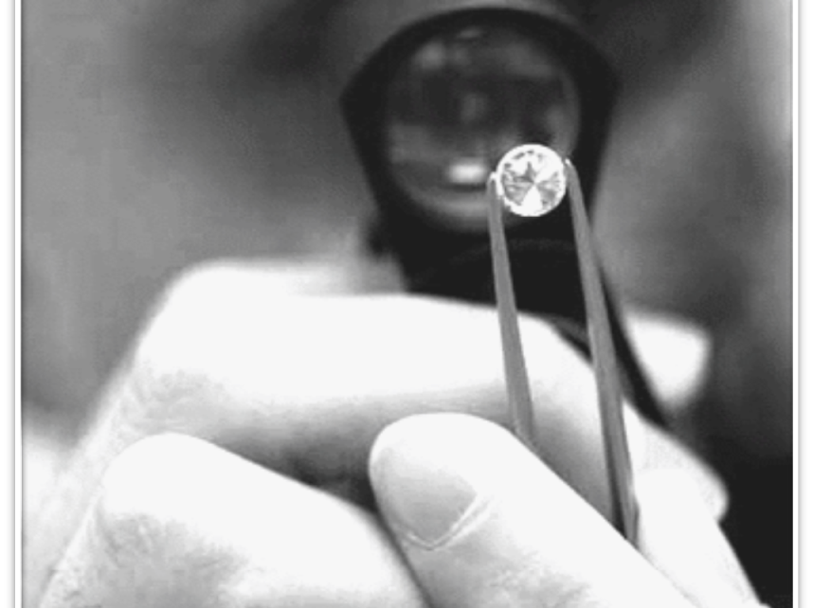
Emmaus Center Psychotherapy Services & Catholic Safeguarding Institute
2018 National Convention of Vicars for the Clergy

Slide 2
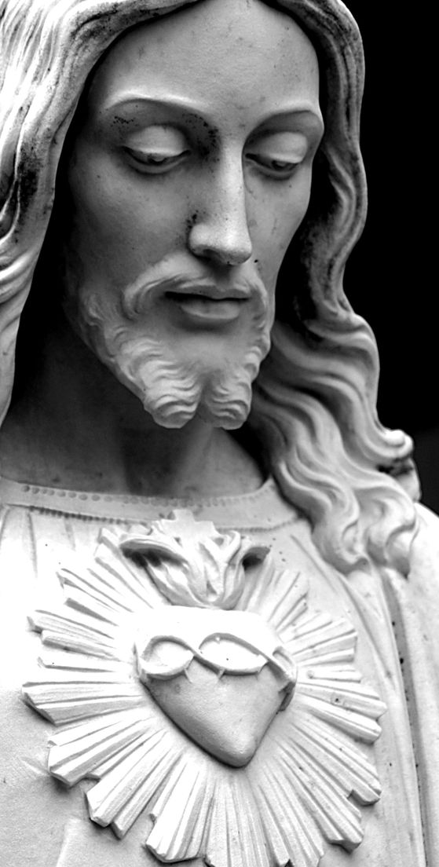
Formation
“ongoing
configuration
to
Christ”
Ratio Fundamentalis Institutionis Sacerdotalis, III.a.28-29. Congregation for the Clergy

Slide 3

Integration: a Life Process

Slide 4
1990
2016
Directives on Formation in Religious Institutes, 42. Cong. for Institutes of Consecrated Life and Societies of Apostolic Life
"Most of the difficulties encountered today in the formation of novices are usually due to the fact that when they were admitted they did not have the required maturity."
Ratio Fundamentalis Institutionis Sacerdotalis, III.a.28-29. Congregation for the Clergy
The Subject of Formation:
integration of humanity and spirituality
Human Formation: The Basis of All Priestly Formation
Affective & Sexual Maturity (Responsible Love)
Pastores Dabo Vobis, 43-44. H.H. Pope S. John Paul II
1992
Notes:
OPTATAM TOTIUS. PROCLAIMED BY HIS HOLINESS Bl POPE PAUL VI ON OCTOBER 28, 1965

Slide 5
Maturity
: Configuration to Christ
Emotional Intimacy
Rest & Recreation
Sexuality
Creativity
Work
Development of Affectivity & Interiority
Personality
Traits & Temperament
Personal
History Relationships
“Self-Talk”
Decisions
Actions
Christian Identity – prayer life
Notes:
*H.E. Jerome Cardinal Hamer, & Abp. Vincenzo Fagiolo. (2 Feb. 1990). Directives on Formation in Religious Institutes. The Congregation for Institutes of Consecrated Life and Societies of Apostolic Life: Rome.
H.E. Beniamino Cardinal Stella, Abp. Joel Mercier, & Abp. Jorge Carlos Patron Wong. (8 December 2016). The Gift of the Priestly Vocation: Ratio Fundamentalis Institutionis Sacerdotalis, 35-40. Congregation for the Clergy: Vatican City.

Slide 6
Where We Intervene
Team Approach
“Self-Talk,”
Decisions, Actions
Affective
& Sexual
Maturity;
Interiority
Spiritual Life &
Ministry
Personality
Traits & Temperament
Personal
History
Identity : Christian : Vocation

Slide 7

personal challenges

Slide 8
Internal & Interpersonal Challenges to Affective Maturity & Healthy Intimacy
Ultimately, growth in healthy intimacy and affective maturity involves naming, claiming and embracing old hurts and negative scripts from families of origin and making conscious decisions to act with integrity.
- Dr. Kevin Mcclone, M.Div., Psy.D., 2009. Comment on the 2008 Vatican Guidelines for the Use of Psychology in the Admission and Formation of Candidates for the Priesthood

Slide 9
Affective Maturity & Healthy Intimacy: Process of Integration vs. Fragmentation
Past → healing: naming, claiming, embracing old hurts and negative scripts
Future → hope: making conscious decisions to act with integrity
- Dr. Kevin Mcclone, M.Div., Psy.D., 2009. Comment on the 2008 Vatican Guidelines for the Use of Psychology in the Admission and Formation of Candidates for the Priesthood

Slide 10
How do we know? Indicators of Affective Maturity
Self-Awareness
Sharing Authentic Self
Initiative & Responsibility (Internal Locus of Control)
Self-Acceptance
Self-Esteem
Healthy Identity
Listening
Dealing with Change
Relational Flexibility
Healthy Solitude
Trust & Mutuality
Self-Care
Sexuality Integration
Capacity for Work
Can Make Use of Means of Formation
-- Dr. Kevin Mcclone, M.Div., Psy.D., 2009. Comment on the 2008 Vatican Guidelines for the Use of Psychology in the Admission and Formation of Candidates for the Priesthood

Slide 11
Serious Concerns
Stability of Sense of Self
Emotional Immaturity
Sexuality Confusion: unintegrated, undifferentiated, immature
Sexual acting-out behaviors
Fluid interpersonal boundaries
Use of pornography or images of child sexual abuse
Interpersonal Difficulties
Difficulty with authority or use of power
Life
Transition
Stress
Burnout
Trauma
Depression, anxiety, personality disorders
Addiction & Addictive Behaviors
Screen Dependency Disorder
Abuse of Digital Technology

Slide 12
Psychotherapy Services
Clinical Interview & Individual Psychotherapy
1
Treatment of Religious & Clergy in Distress (TRACT Program)
2

Slide 13
Psychotherapy Process
Priest or superior contacts Emmaus: Mrs. Paz Baquiran
Triage by Paz to Emmaus Center Psychotherapist
Initial Clinical Interview
Informed Consent, Confidentiality
Inclusion of Superior in Information Loop? To what degree?
Limits: Harm to self, harm to others
Treatment Planning
Goals, Frequency of Visits, Type of Psychotherapy
Referrals (SD, Medical, etc.)
Treatment / Psychological Accompaniment Proper
Beginning – Middle – End
Ongoing evaluation of goals
Ending Treatment
Definite end
Maintenance visits? (every 3 months or twice a year)

Slide 14
TRACT Process
Superior Contacts Emmaus (Dr. Inge del Rosario)
Orientation by TRACT Director (Dr. Inge del Rosario)
Intensive Interview (3 hours)
Spiritual Life Interview (2 hours)
Sexuality Interview (2 hours)
Addictions Interview (2 hours)
Psychological Testing (2 days)
Psychiatric & Medical Evaluations (2-3 hours)
Team Meeting & Discussion (2-3 hours)
Discussion of assessment report and treatment recommendations with Client, and Client & Leadership
Treatment Referrals
Outpatient: psychotherapy, spiritual direction, sexual wellness counseling, addictions treatment, psychiatry, medical intervention, community support
Inpatient: Galilee, Nazareth, Hospital, etc.

Slide 15
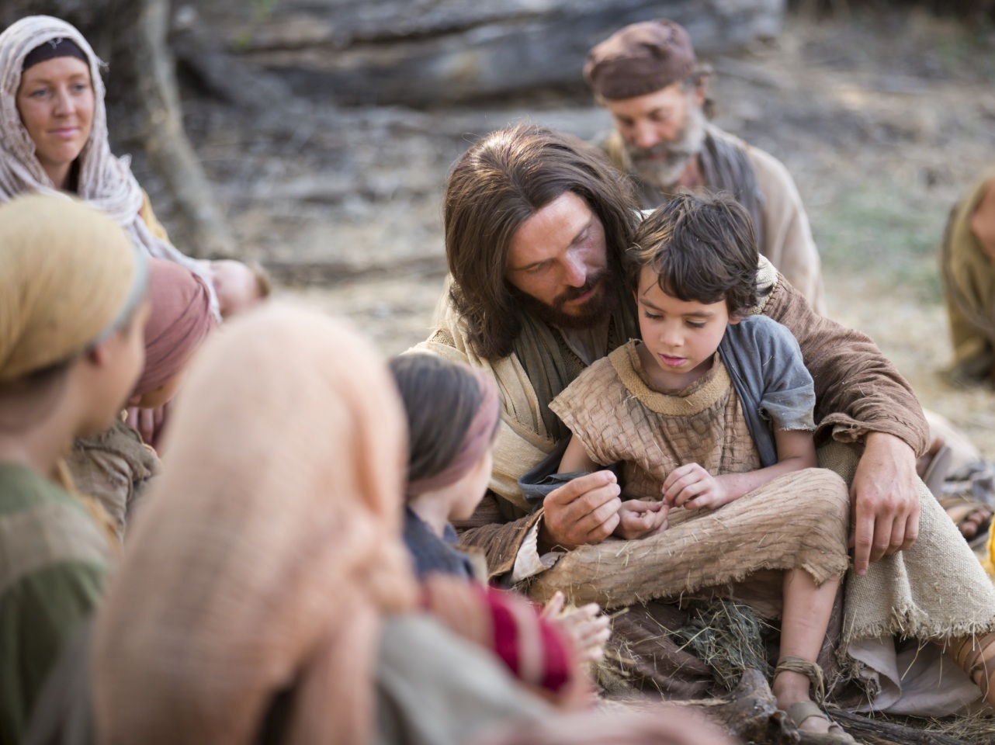
The Catholic Safeguarding Institute: Formation in Safeguarding

Slide 16
Safe Relationships, Safe Environments

Slide 17
CSI Formation Programs
Formation Workshops
Leadership & Formators
Launch: July 2018
Diploma Course in Safeguarding
1-semester intensive, 30 graduate ecclesiastical credits
Collaborators: Loyola School of Theology & Pontifical Gregorian University
For Safeguarding Officers, Directors of Work (Diocesan, Religious, Lay)
Launch: January or August 2019 (anticipated)

Slide 18
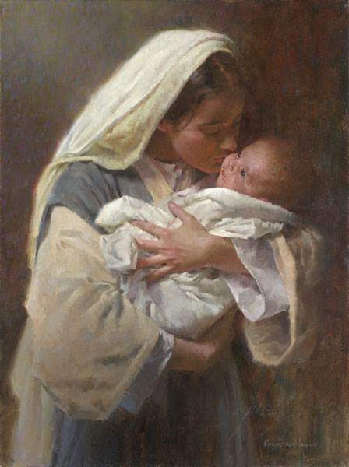
Thank you!

